Slide 1
Supplementary Data
Alpha Diversity
Dominance (Alpha)
Beta Diversity
Functional Diversity

Slide 2
Alpha diversity

Slide 3
Alpha Diversity, within timepoints, all groups No testing – n=3

Slide 4
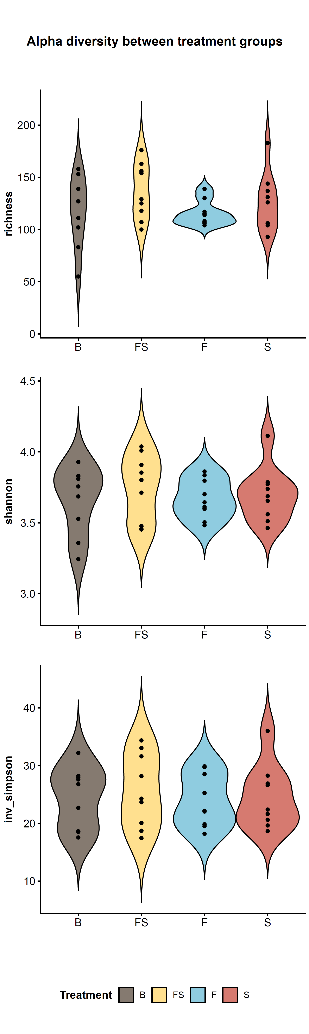
Alpha Diversity, all points, testing between groups n=6-18
Alpha Diversity, all timepoints, all groups.
KW testing. Where significant differences, follow up with Wilcoxon
Sig diff: Between Timepoints, for Shannon and Inverse Simpson (not Richness)

Slide 5
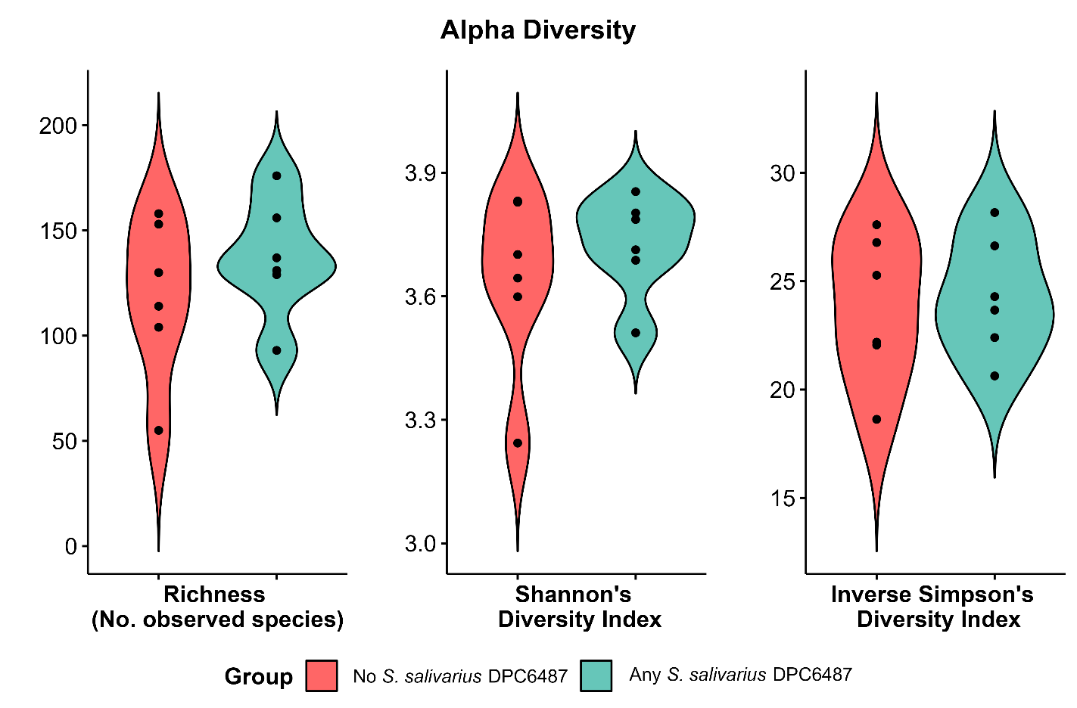
Alpha Diversity, T_24

Slide 6
Dominance

Slide 7
Dominance, between each timepoint (all groups)

Slide 8
Dominance, between each group (all timepoints)

Slide 9
Dominance, between any exposure (all timepoints)

Slide 10
Dominance, within each group at each timepoint
Dominance, all timepoints, all groups
No testing (n=3)

Slide 11
Dominance, between each timepoint (comparing Strep exposure)

Slide 12
Dominance at T_24 (comparing Strep exposure)

Slide 13
Dominance at T_24 (comparing by dominant species)

Slide 14
Beta-diversity (Taxonomic)

Slide 15
Beta – all timepoints – Robust Aitchisons

Slide 16
Beta – all timepoints – Bray Curtis

Slide 17
Beta – all timepoints – Unweighted UNIFRAC

Slide 18
Beta – all timepoints – Weighted UNIFRAC

Slide 19
Beta – T_24 only – all metrics

Slide 20
Functional diversity

Slide 21
Func – beta – SF1

Slide 22
Func – beta – SF2

Slide 23
Func – beta – SF3

Slide 24
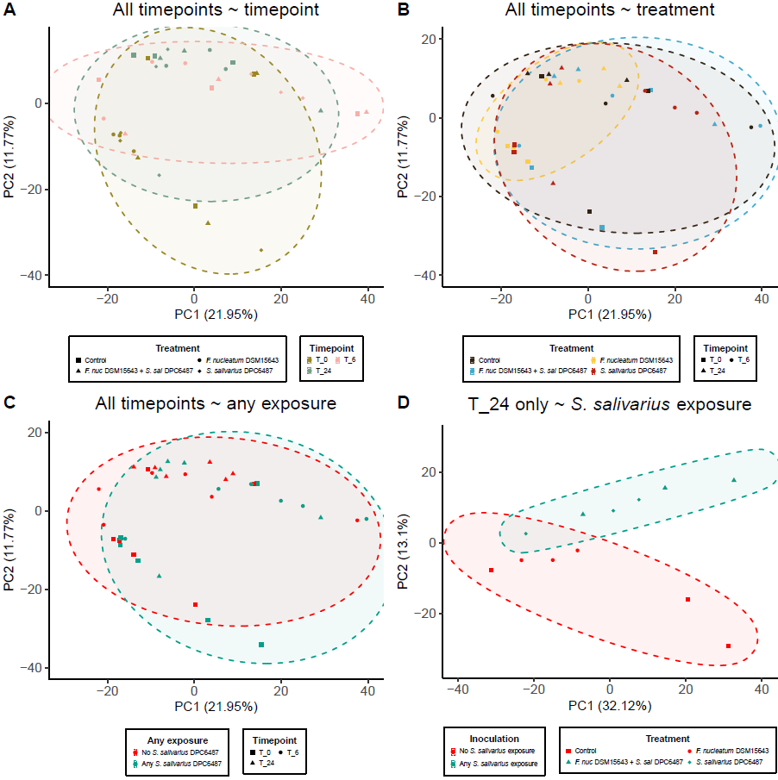
Func – beta – HUMAnN4 stratified

Slide 25
Func – beta - HUMAnN4 unstratified

